Slide 1



Data model and tagging
© Paul Uithol

Slide 2
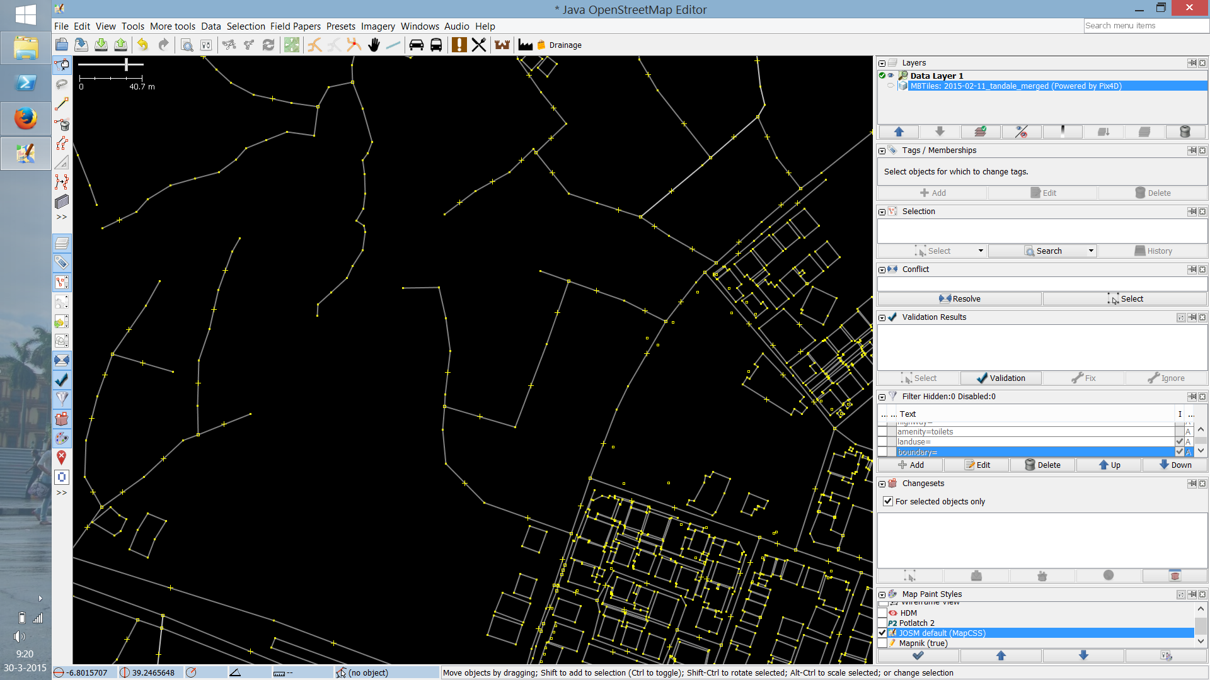
Why tagging?

Slide 3
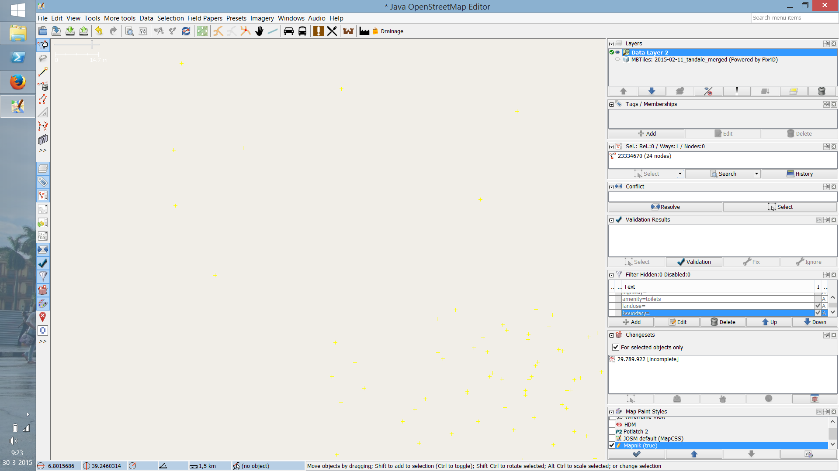
.. otherwise the map will be like this:

Slide 4
Why tagging?
Is this line… a road? A river? A railroad?
Add meaning
Communication and agreement
to viewers
to other mappers
to other computers/APIs
to the map renderer!

Slide 5
What is a tag exactly?
“a label attached to someone or something
for the purpose of identification, or to give
other information.”

Slide 6
Categorize, to add information that is useful for:
understanding of the map
planning
routing
querying
many other use cases!

Slide 7
In OpenStreetMaps:
a key describes a property of a feature,
specifying one or more values
Each feature should have one or more tags!

Slide 8
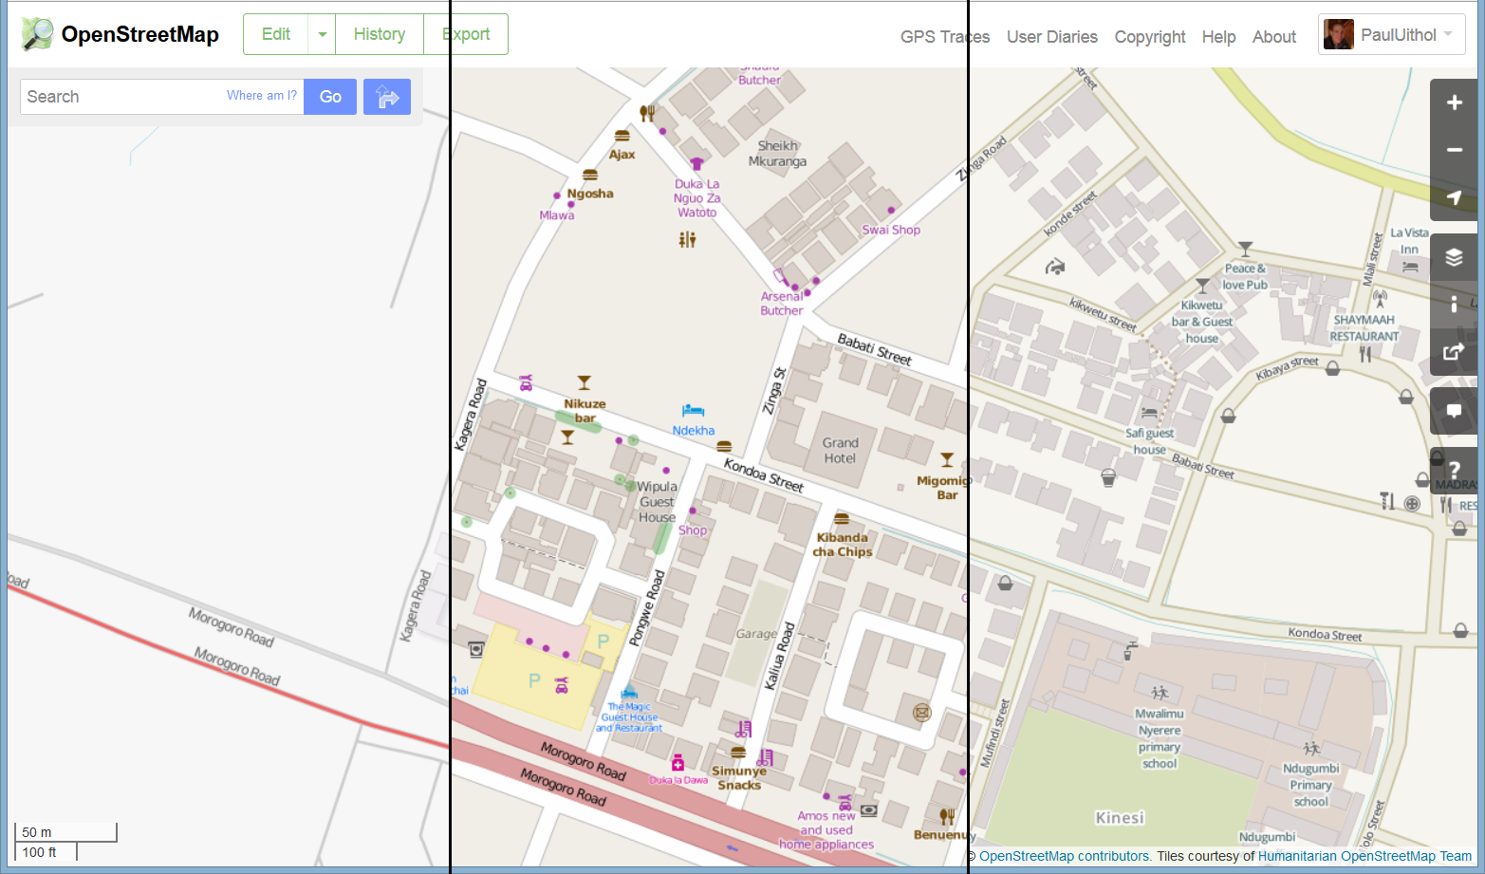
Renderers

Slide 9
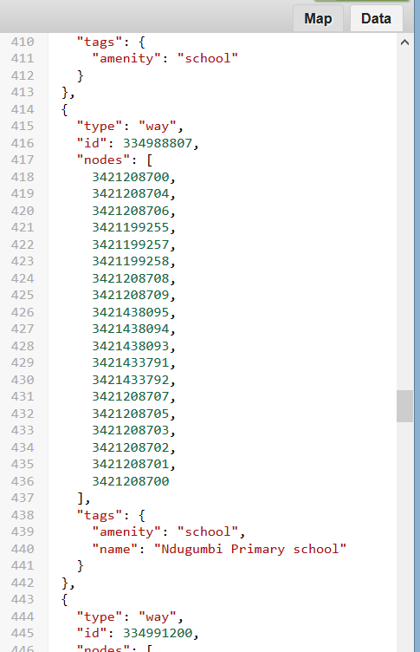
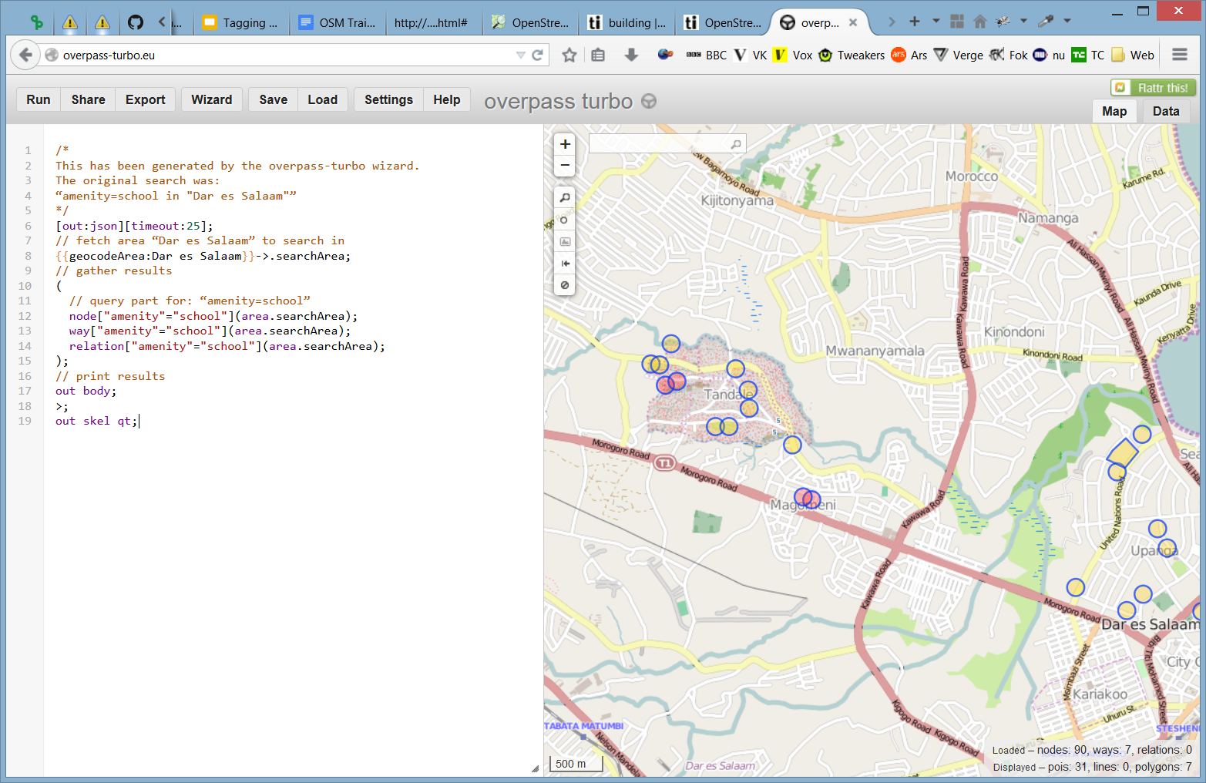
API
http://overpass-api.de/
http://overpass-turbo.eu/

Slide 10
Our data model
drainage
stream, drain, ditch, culvert
sanitation
drinking water, water tank, public toilet
roads
tertiary, unclassified, residential, footway
buildings
landuse
http://wiki.openstreetmap.org/wiki/Map_Features

Slide 11
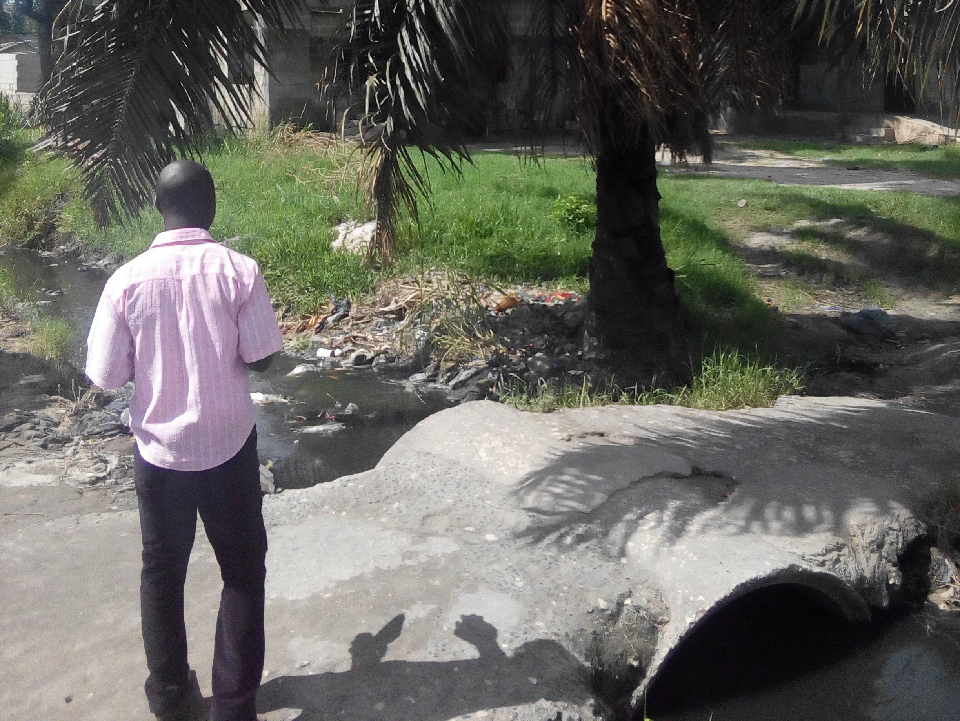
Drainage - stream
Naturally occurring
.. with a little bridge here

Slide 12
Drainage - stream
Required tags:
waterway=stream
If possible:
depth=<number> (in meters, no unit; so “depth=1”)
width=<number> (in meters, no unit; so “width=2”)

Slide 13
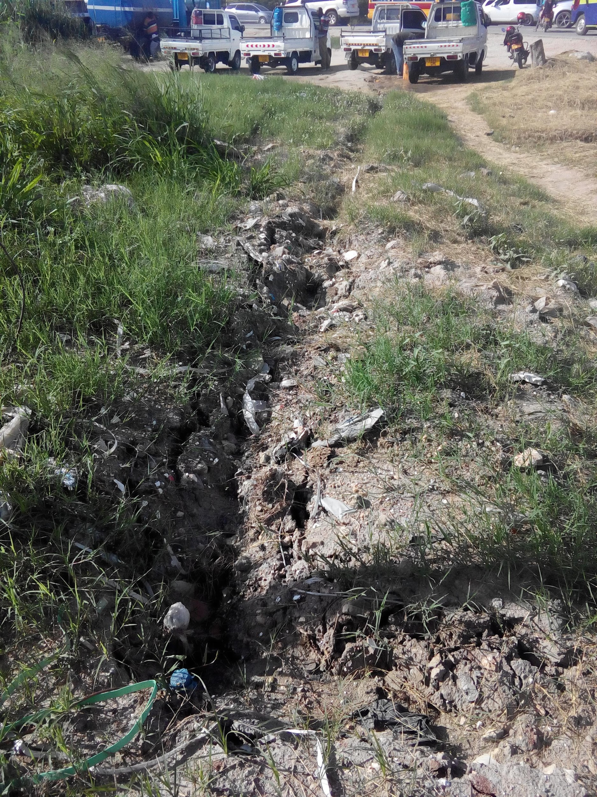
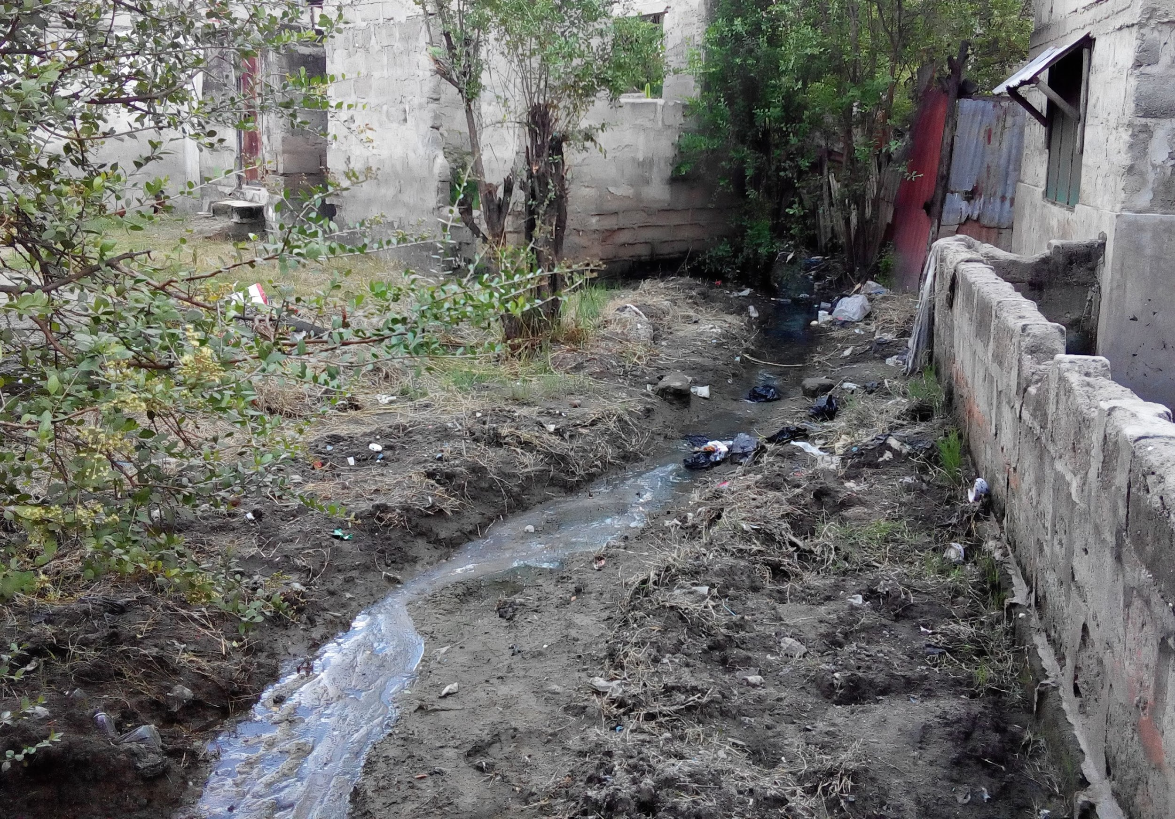
Drainage - ditch
Usually artificial
Depression or dug out, earth

Slide 14
Drainage - ditch
Required tags:
waterway=ditch
If possible:
depth=<number> (in meters, no unit; so “depth=1”)
width=<number> (in meters, no unit; so “width=2”)
covered=yes/no
blockage=dirt/concrete/rubbish/

Slide 15
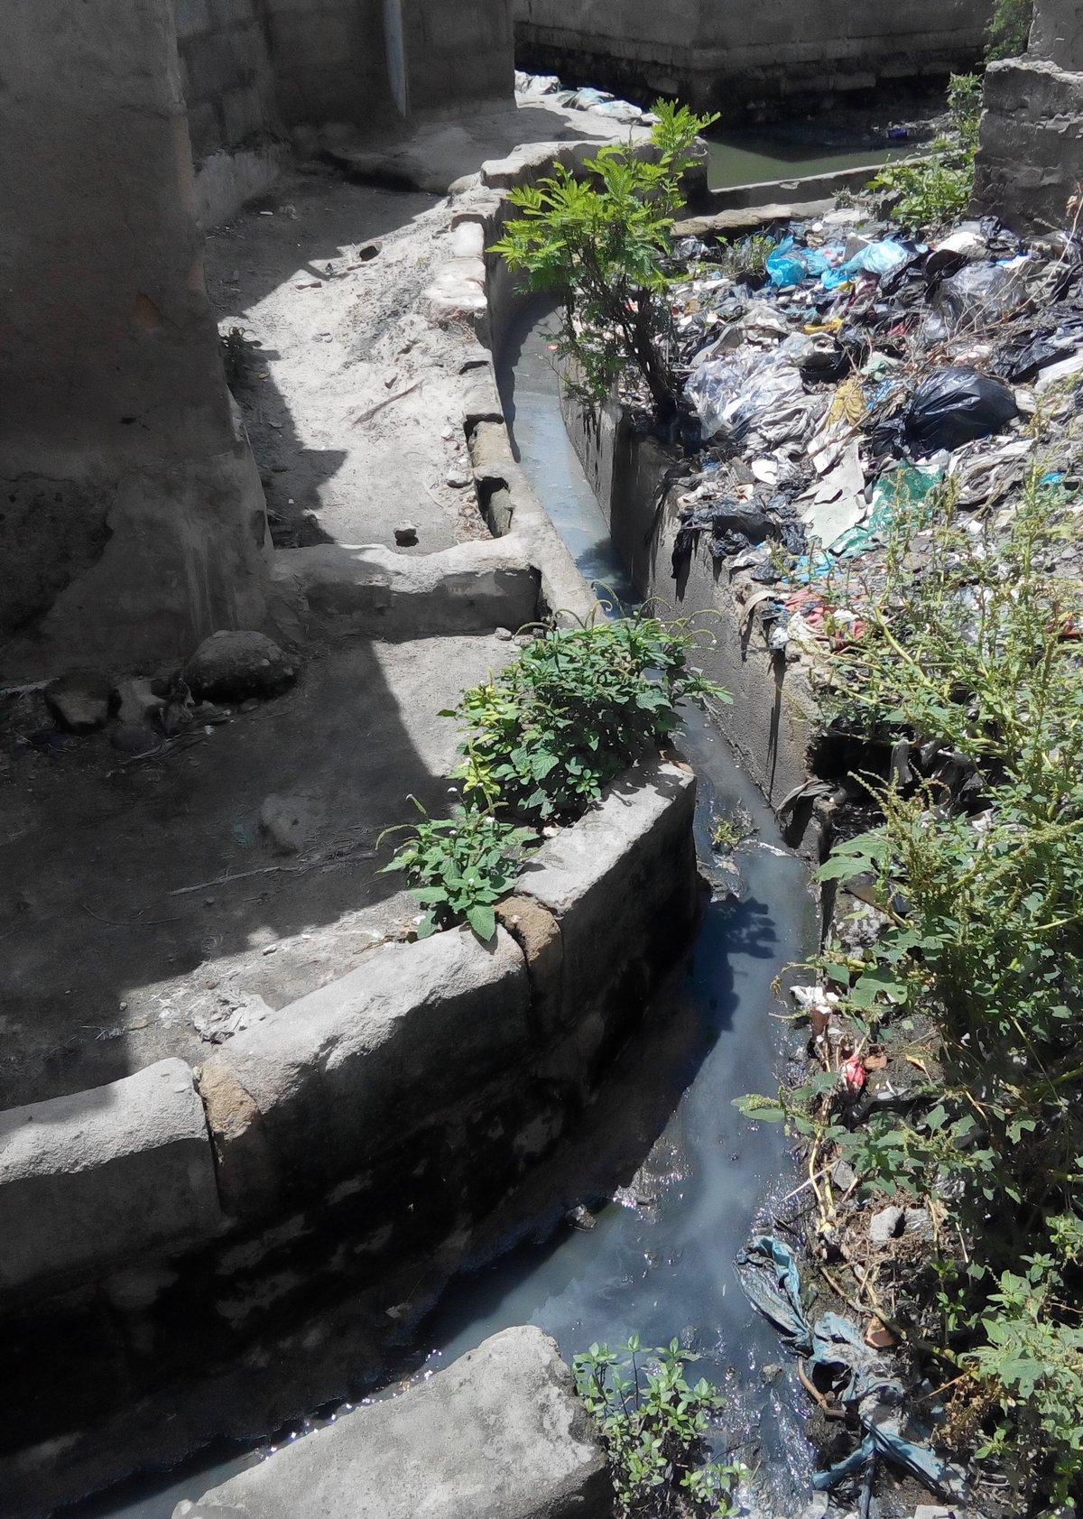
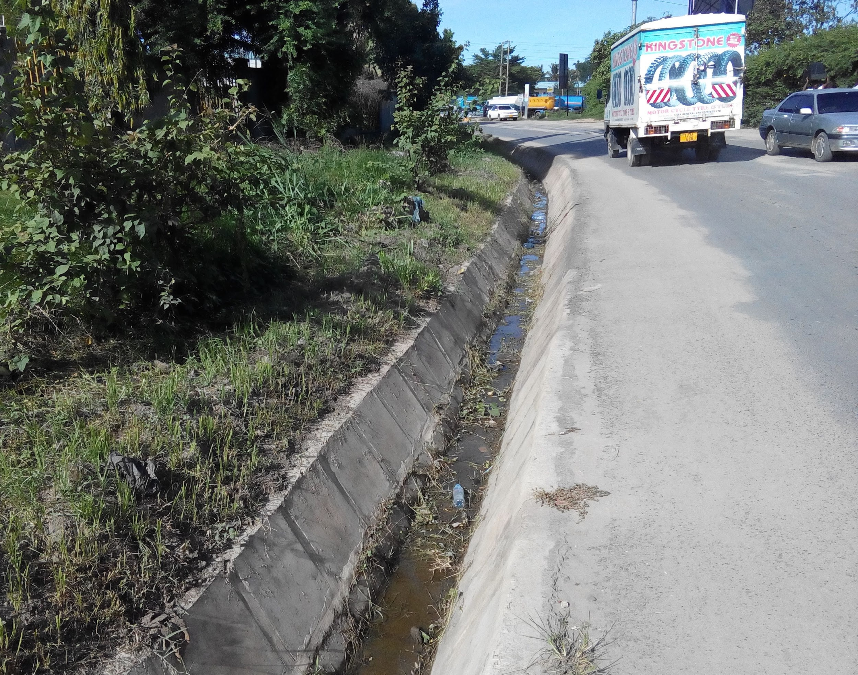
Drainage - drain
Artificial
Reinforced, brick or concrete

Slide 16
Drainage - drain
Required tags:
waterway=drain
covered=yes/no
If possible:
diameter=<number> (in meters, no unit; so “diameter=1”)

Slide 17
Drainage - underground drain
Required tags:
waterway=drain
covered=yes
layer=-1
If possible:
diameter=<number> (in meters, no unit; so “diameter=1”)

Slide 18
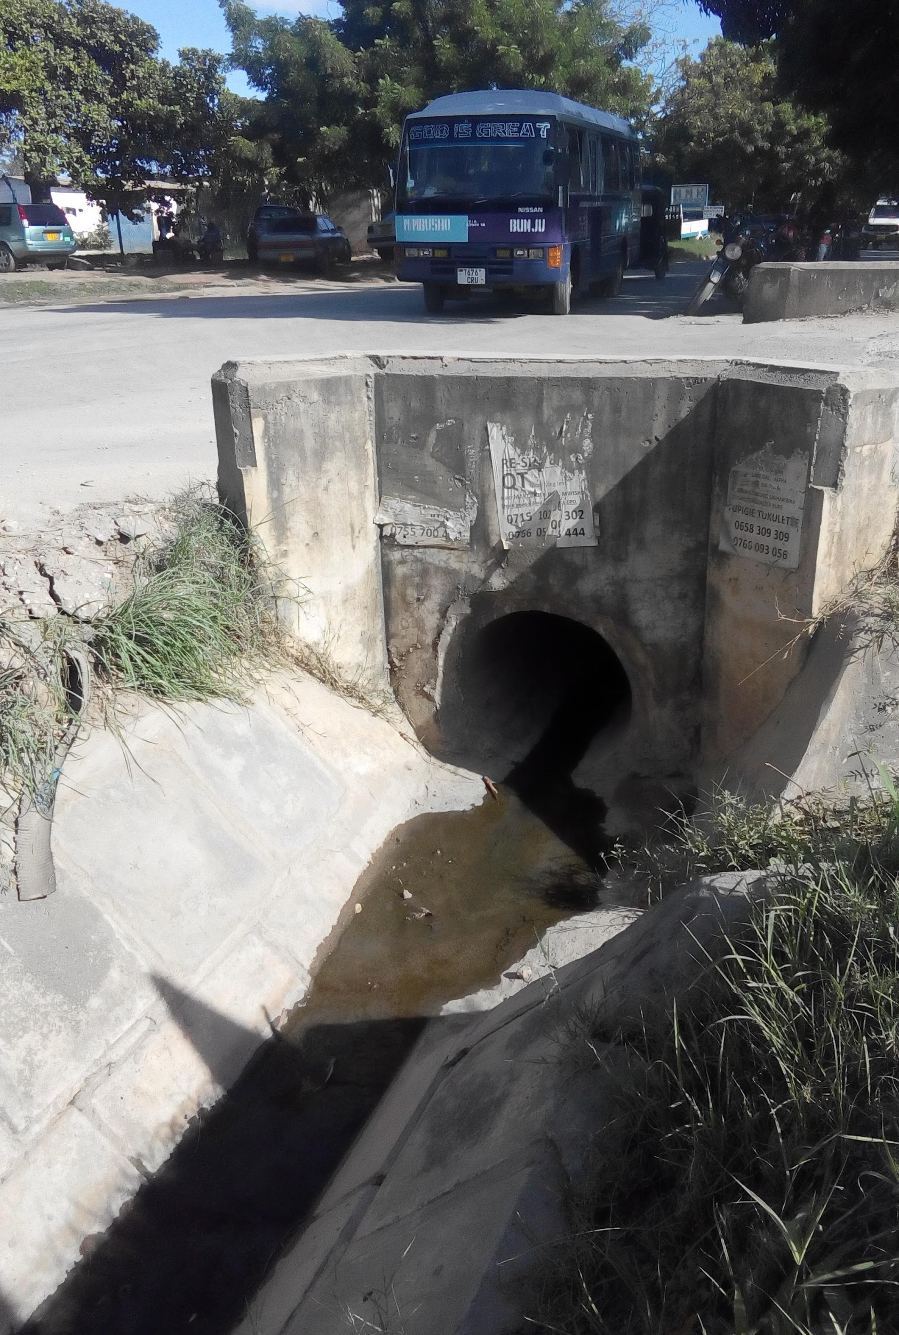
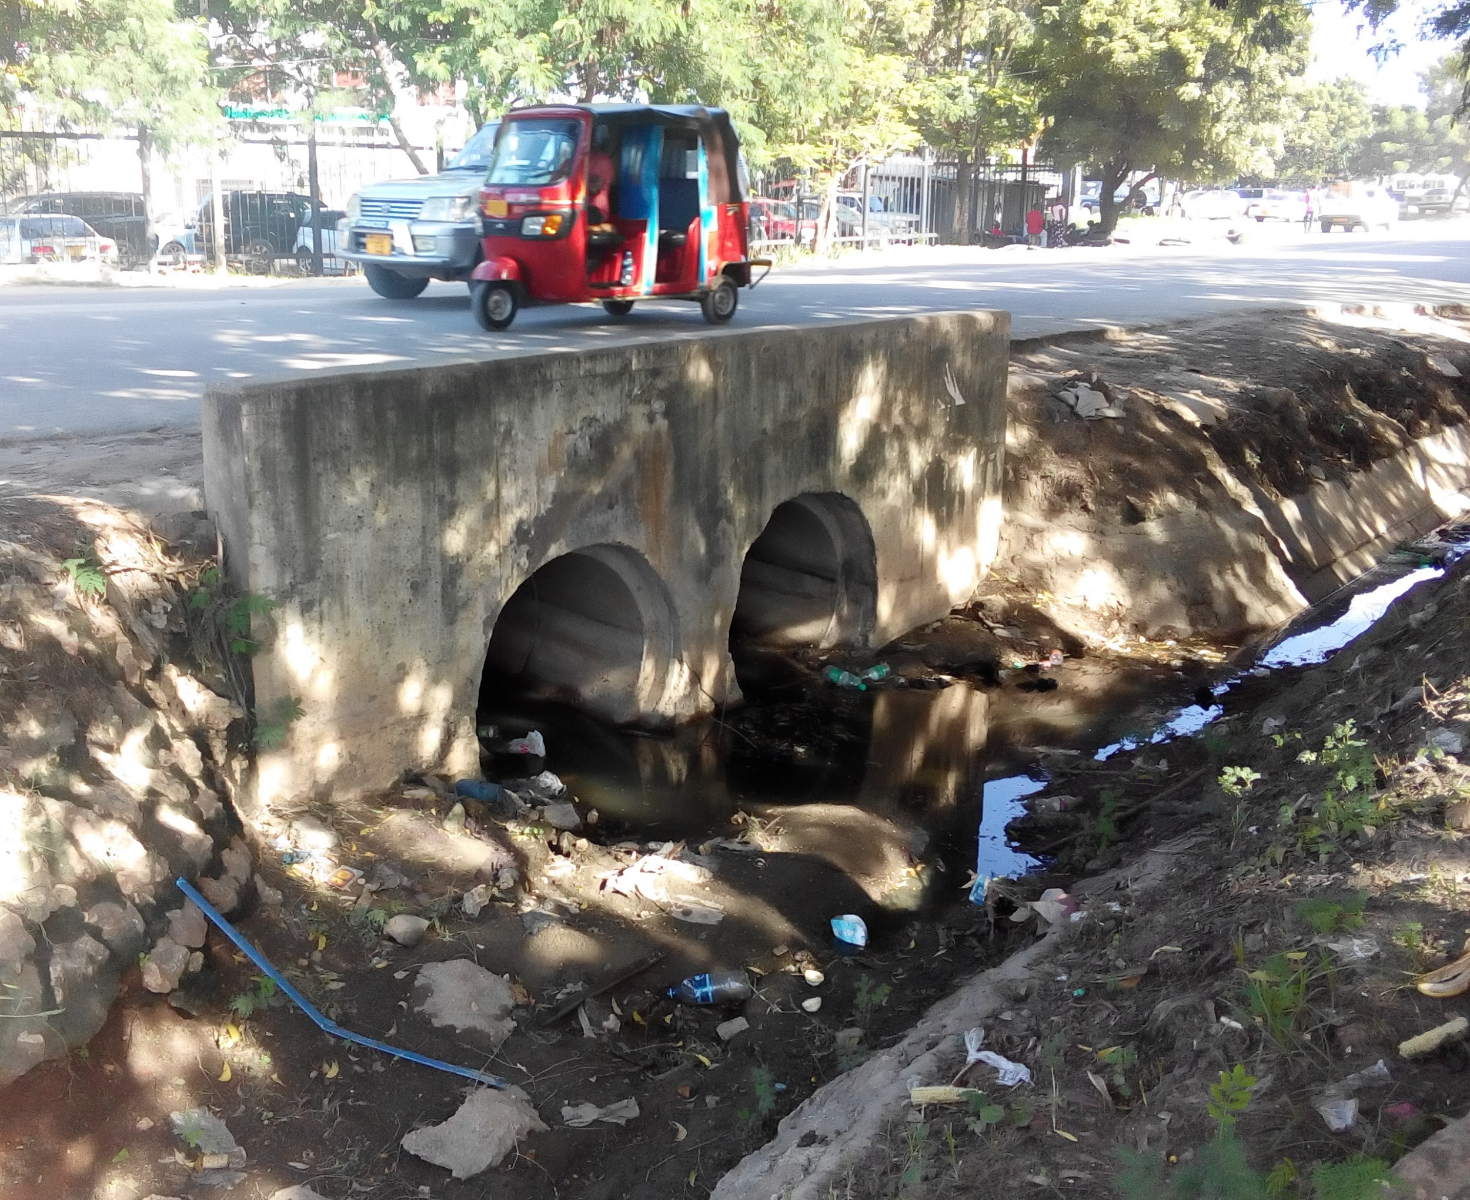
Drainage - culvert
Tunnel, usually on a drain or a ditch

Slide 19
Drainage - culvert
Required tags:
waterway=drain
tunnel=culvert
covered=yes
layer=-1
If possible:
diameter=<number> (in meters, no unit; so “diameter=1”)

Slide 20
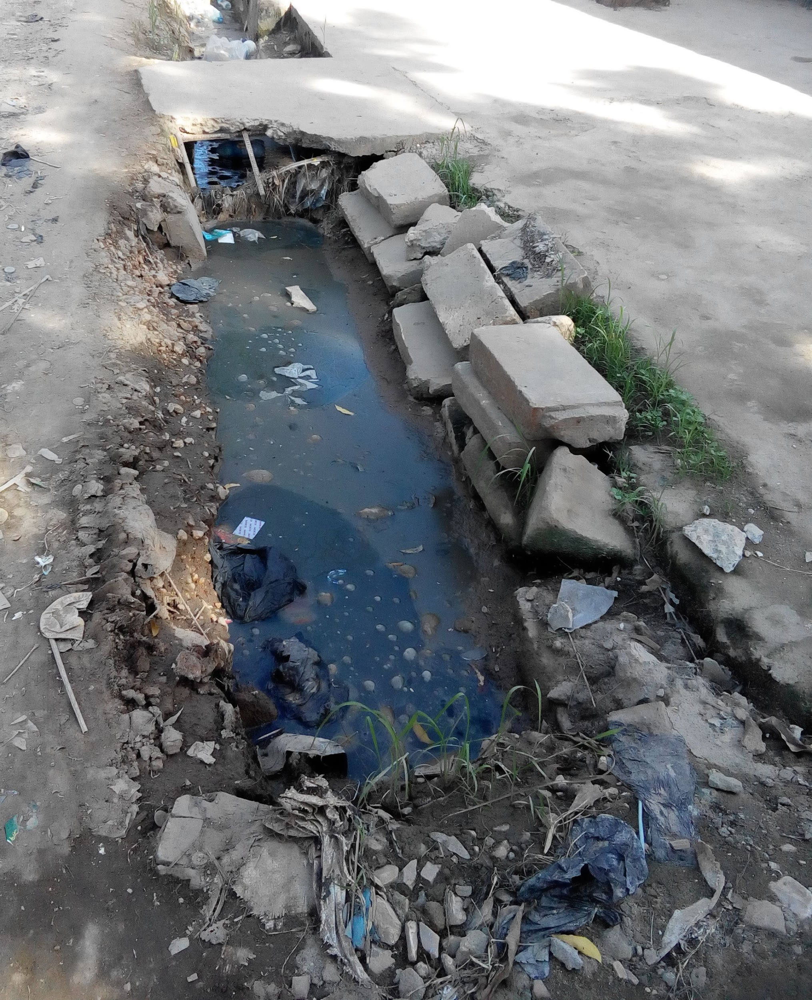
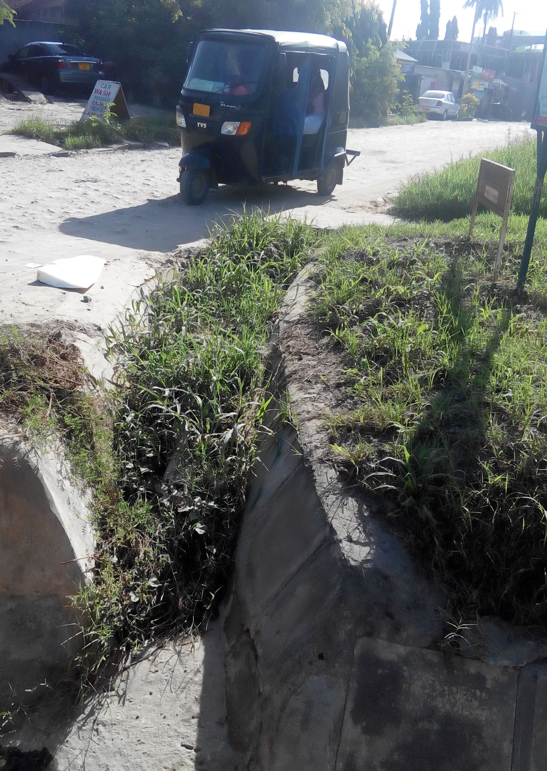
Blockage!
Tag part of the drain or ditch with “blockage=yes”
(or concrete, rubbish)

Slide 21
Streets
highway = primary, secondary, tertiary, unclassified, residential, footway
name
surface = asphalt, concrete, unpaved
smoothness = good, intermediate, bad, very_bad, horrible
width=<number> (in meters, no unit; so “diameter=1”)
oneway=yes/no (direction of traffic, NOT lanes!)
bridge=yes,viaduct (only add if it’s a bridge; also add layer=1)

Slide 22
Buildings
building (the general type)
= residential, commercial, apartments, industrial, public, school, utility, construction
Multiple values: list with semi-colons, so “residential;commercial”
building:levels (the ground floor counts as 1!)
building:material
= brick, cement_block, concrete, glass, loam, metal, plaster, wood
addr:street=<street name; English suffixes (Street, Road), watch capitalization!>
addr:housenumber=<address number of the building, ie 25 or 19A>

Slide 23
Buildings (continued)
amenity (public use)
= (for example) atm, bank, bar, fuel, clinic, doctor, hospital, mall, market
police, place_of_worship, public_building, restaurant, school, town_hall,
office = company, government, insurance, lawyer, political_party, yes
shop = beverages, car_repair, convenience, greengrocer, kiosk, etc
tourism = attraction, guest_house, hotel, yes
religion = muslim, christian, buddhist, ? (only if amenity=place_of_worship!)
bed_count=<number> (for hospitals, clinics; the amount of patients it can handle)

Slide 24
Open areas
wetlands/flood prone: “natural=wetland”
solid waste: “landuse=dump, official=yes/no”
cemetery: “landuse=cemetery”
park: “leisure=park”
playground: “leisure=playground”
ponds: “natural=water”
sports pitch: “leisure=pitch, landuse=recreation_ground”

Slide 25
Other
water source: “amenity=drinking_water”, “man_made=water_well”
public(!) toilets: “amenity=toilets”
mobile money: “amenity=money_transfer, operator=<name>”

Slide 26
If in doubt
http://wiki.openstreetmap.org/wiki/Map_Features
http://taginfo.openstreetmap.org/
or ask us!

